Slide 1
Random Sampling using Ranint

Slide 2
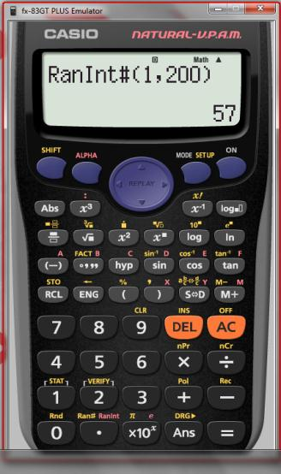
Random Sampling using Ranint for an interval [1,200]

Slide 3
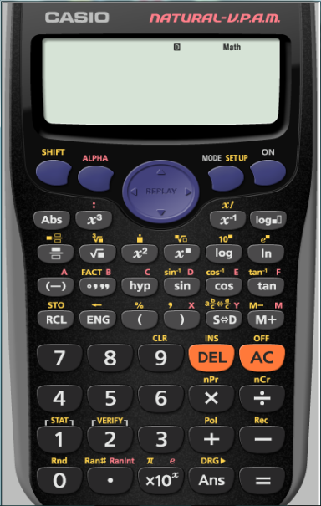
Random Sampling using Ranint for an interval [1,200]
Ranint is in Red

Slide 4
Random Sampling using Ranint for an interval [1,200]

Slide 5
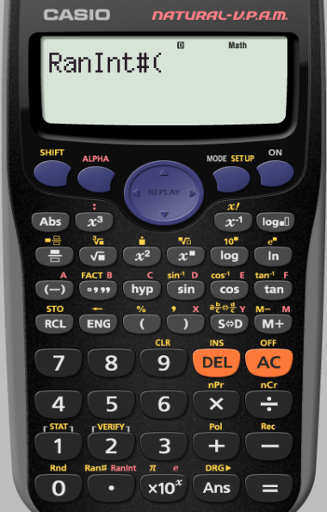
Random Sampling using Ranint for an interval [1,200]
We want our interval to be
[1,200]

Slide 6
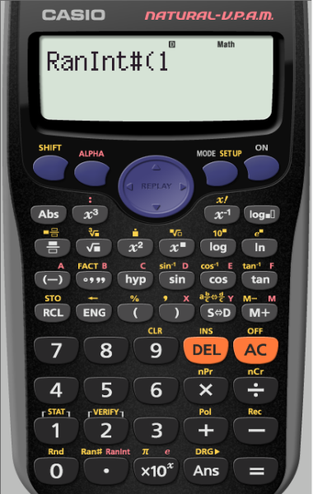
Random Sampling using Ranint for an interval [1,200]
The comma is here in yellow

Slide 7
Random Sampling using Ranint for an interval [1,200]
The comma is here in yellow

Slide 8
Random Sampling using Ranint for an interval [1,200]

Slide 9
Random Sampling using Ranint for an interval [1,200]

Slide 10
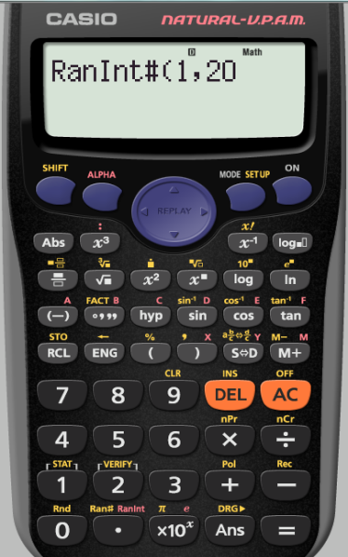
Random Sampling using Ranint for an interval [1,200]

Slide 11
Random Sampling using Ranint for an interval [1,200]
The bracket is here

Slide 12
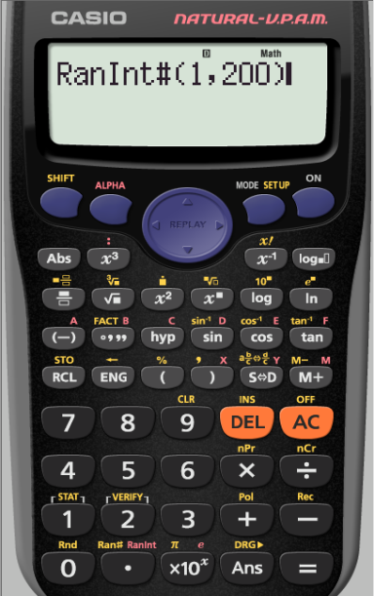
Random Sampling using Ranint for an interval [1,200]
To keep generating a random 3 digit number between
[1,200]
we repeatedly press
=

Slide 13
Random Sampling using Ranint for an interval [1,200]

Slide 14
Random Sampling using Ranint for an interval [1,200]

